Slide 1
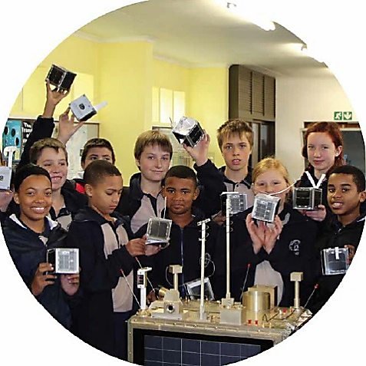
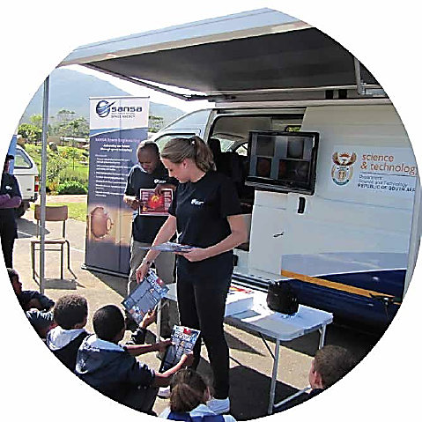
Tender No SS/021/05/2021 Science Centre Exhibit Development and Maintenance Panel

Slide 2
Tender No SS/021/05/2021 Science Centre Exhibit Development and Maintenance Panel
Eligibility Criteria – To bid organizations must provide:
A fully completed and signed Bid Document
A certified proof of company registrations.
CSD Registration Summary with a tax compliant status
Failure to comply with the above mandatory submission requirements will invalidate the bid.

Slide 3
Tender No SS/021/05/2021 Science Centre Exhibit Development and Maintenance Panel SCOPE OF WORK
SANSA requires exhibits that will demonstrate Science, Technology, Engineering, Mathematics and Innovation (STEMI) concepts through visual and interactive means.
The purpose of this tender is to appoint a panel of suitably qualified and experienced service providers to (services required includes but are not limited to the list below):

Slide 4
Tender No SS/021/05/2021 Science Centre Exhibit Development and Maintenance Panel SCOPE OF WORK
Conceptualize exhibits and develop innovative designs related to space science
Build interactive exhibits / models
Supply and/or design systems and associated subsystems
Supply and/or manufacture specialized components for exhibits
Repair and/or refresh existing exhibits
Supply transparent enclosures depending on the sensitivity and safety requirements.
Provide clear written instructions and in-person training on how to operate the exhibit

Slide 5
Tender No SS/021/05/2021 Science Centre Exhibit Development and Maintenance Panel SCOPE OF WORK
The SANSA branding guidelines should be adhered to
Deliver the exhibits to SANSA in Hermanus, Western Cape
Exhibits should be either table-top, on a pedestal or wall-mounted, depending on the SANSA requirements and type of exhibit
• In some cases, the exhibits may be required to be mobile so as to travel to festivals or within the SANSA Mobile Lab
• Exhibits may require coding or application development to ensure that they are interactive and can engage with today’s learners

Slide 6
Tender No SS/021/05/2021 Science Centre Exhibit Development and Maintenance Panel EVALUATION CRITERIA
Scores will be tabulated to 100 points. Respondents must score 70 points and above to be appointed on panel

Slide 7
Tender No SS/021/05/2021 Science Centre Exhibit Development and Maintenance Panel EVALUATION CRITERIA (Pages 36-39)
Evaluation criteria 1: Product portfolio on previous exhibit building/ model building projects
The bidder is to provide a comprehensive portfolio (in colour) of previously completed exhibits showing functionality in relation to Science, Technology, Engineering, Mathematics and Innovation (STEMI) concepts.
Bidder to indicate capacity to supply and/or manufacture exhibit or model components/subsystems. Bidder should also indicate capacity to repair\refresh existing exhibits.
Bidder will be evaluated on completeness and relevancy to build exhibits for the SANSA Science Centre. Bidder should also indicate ability to deliver completed exhibits to SANSA in Hermanus in the Western Cape.

Slide 8
Tender No SS/021/05/2021 Science Centre Exhibit Development and Maintenance Panel EVALUATION CRITERIA (Pages 36-39)
Evaluation criteria 2: Company Experience
The experience of the tenderer (company) in similar projects and conditions in relation to the scope of work will be evaluated.
Bidder should very briefly describe their experience in this regard and attach this to this schedule.
The description should be put in tabular form with the following headings:
Evaluation criteria 3: References
The references for similar projects completed in relation to the scope of work will be evaluated.
Letters provided will be advantageous. Please note that SANSA will contact supplied references as part of the due diligence process for tender awards.

Slide 9
Tender No SS/021/05/2021 Science Centre Exhibit Development and Maintenance Panel GENERAL POINTS
→ Tender documentation = Tender Document + ALL other supporting documents.
→ Please read carefully the requirements and ensure that your proposal addresses
our requirements
→ Bidders should fully complete and sign all documents
→ Proposals will be evaluated by an evaluation panel, and adjudicated by the
SANSA central Bid Adjudication Committee (BAC)
→ Tender Closing date – 2 August 2021 at 11:00

Slide 10
Tender No SS/021/05/2021 Science Centre Exhibit Development and Maintenance Panel
Nicole Strauss
nstrauss@sansa.org.za
028 285 0048

