Slide 1
SANSA HERMANUS - briefing session for Exhibit Building Panel

Slide 2
LOCATION OF SANSA
Madimbo
Windhoek
MOZAMBIQUE
BOTSWANA
Pretoria
Hartebeesthoek
NAMIBIA
SWAZILAND
Louisvale
Upington
Bloemfontein
Springbok
LESOTHO
Durban
Sutherland
Grahamstown
East London
Hermanus
Grahamstown
Cape Town
Port Elizabeth

Slide 3
SANSA OVERVIEW

Slide 4
Science Engagement Unit
Science Engagement Vision
To be the leader in stimulating and engaging the South African youth and society in the promotion and use of space science and technology for sustainable development.
Science Engagement Mission
To provide leadership in Space Science content for the youth and diverse constituents at all levels of society in order to stimulate interest in Space Science and Technology.
Science Centre Purpose
The SANSA Science Centre is dedicated to the inspiration of the youth through the utilisation of space as a driver to create excitement in science, technology, engineering and innovation. The Science Centre is an infrastructure platform that provides access to science and technology through interactive engagements that assists youth of all ages to connect with science.

Slide 5
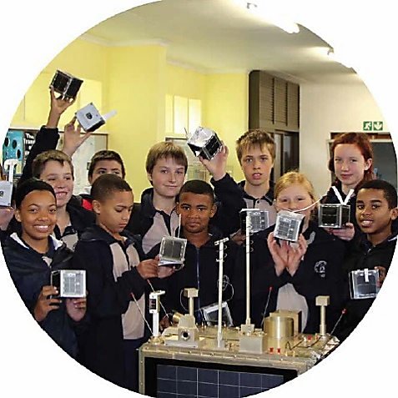
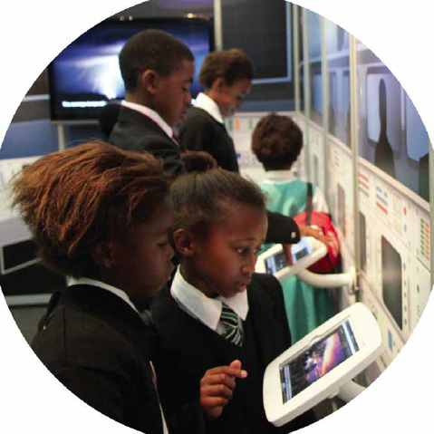
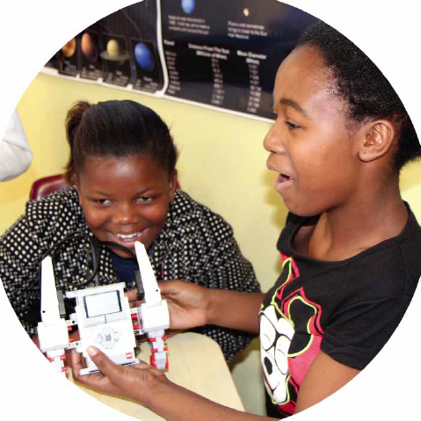
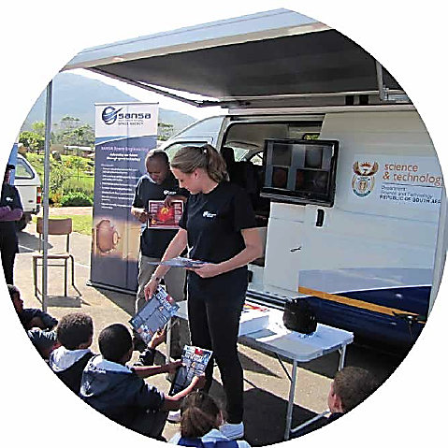
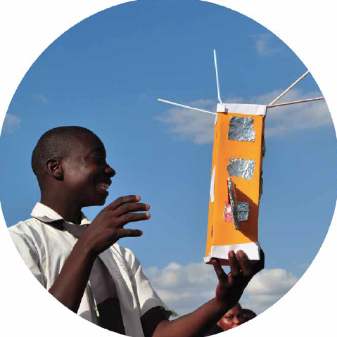
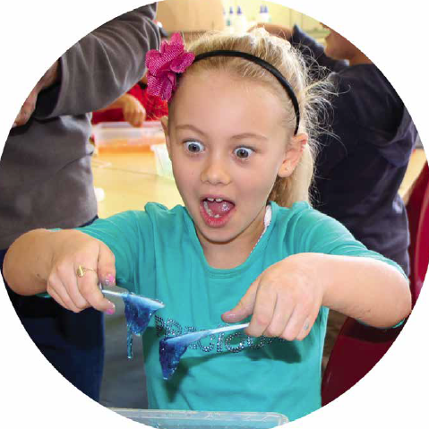
Science Engagement

Slide 6
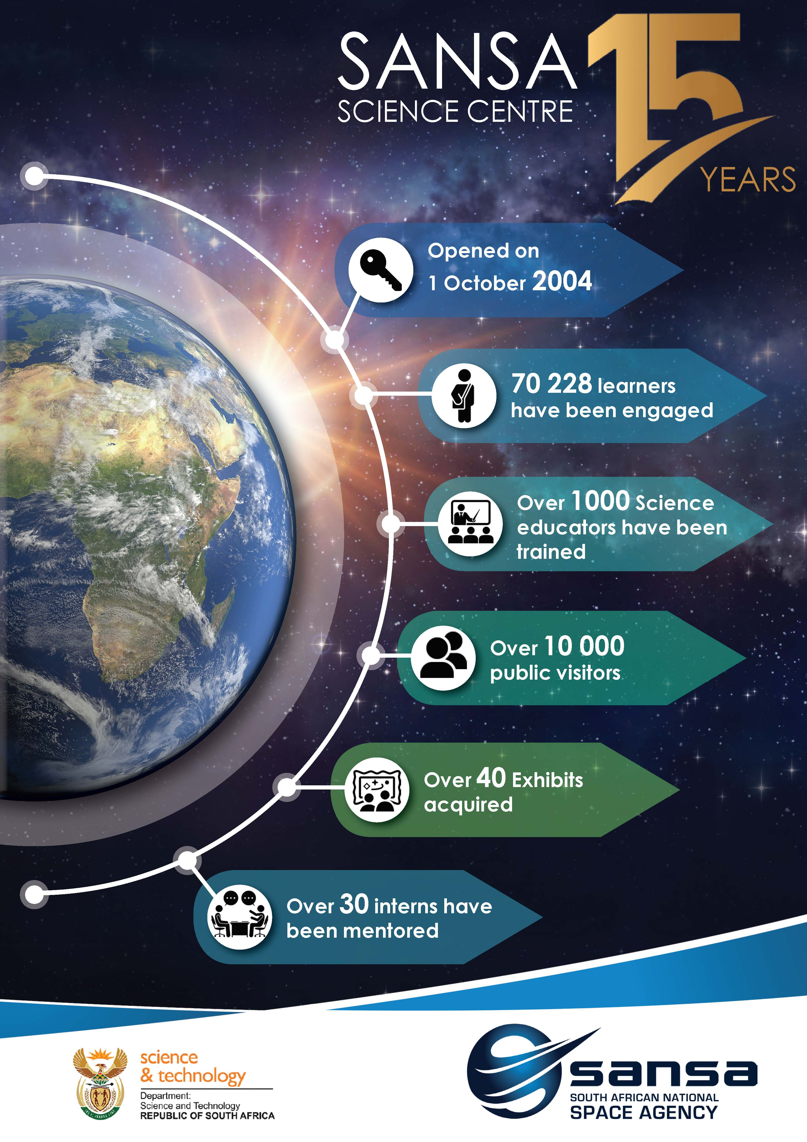
SANSA SCIENCE CENTRE
Opened in October 2004
Celebrated 15 years in 2019
Saw more than 10 000 learners in 2019/20 Financial Year
Reaches communities within a 200 km radius
Includes a Mobile Lab that reaches beyond that

Slide 7
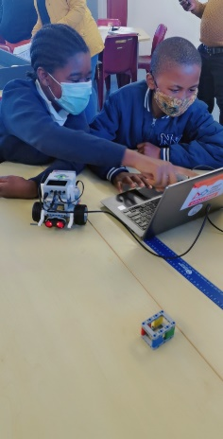
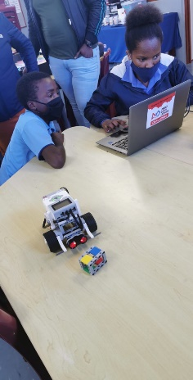
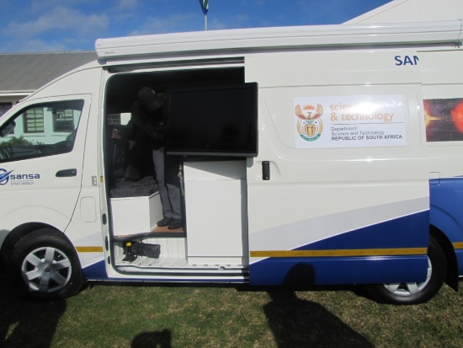
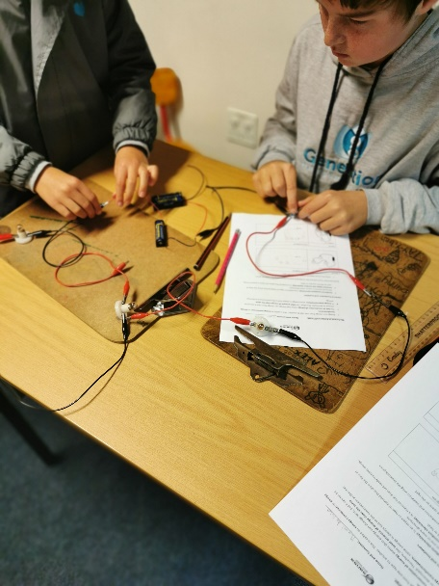
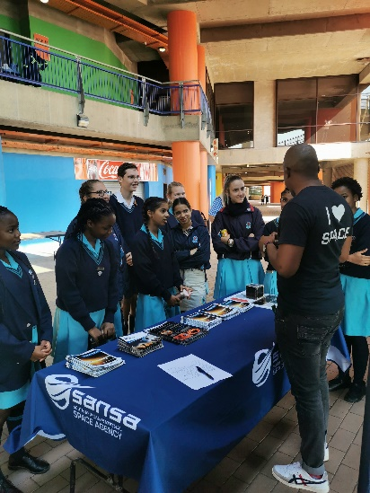
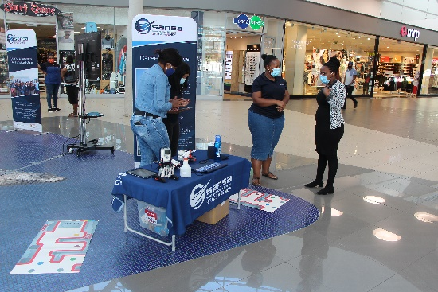
Science Engagement Activities
Science Center
School Visits
Educator Training
Mobile Lab
Public Awareness
Notes:
Science advancement

Slide 8
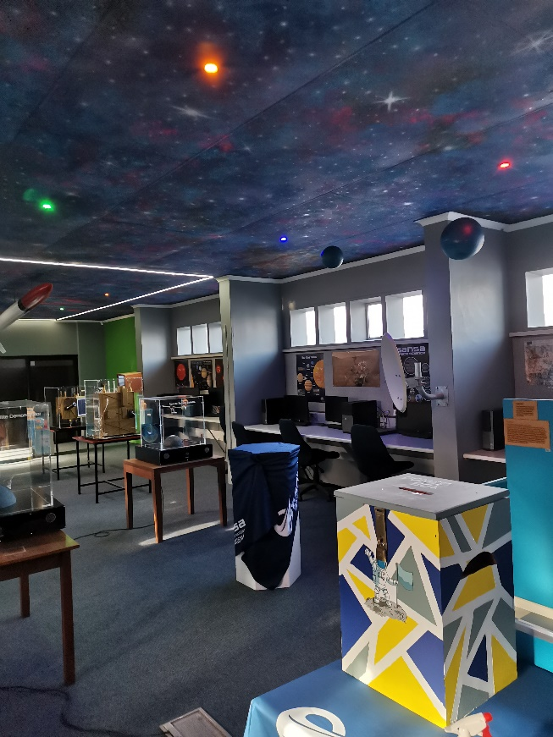
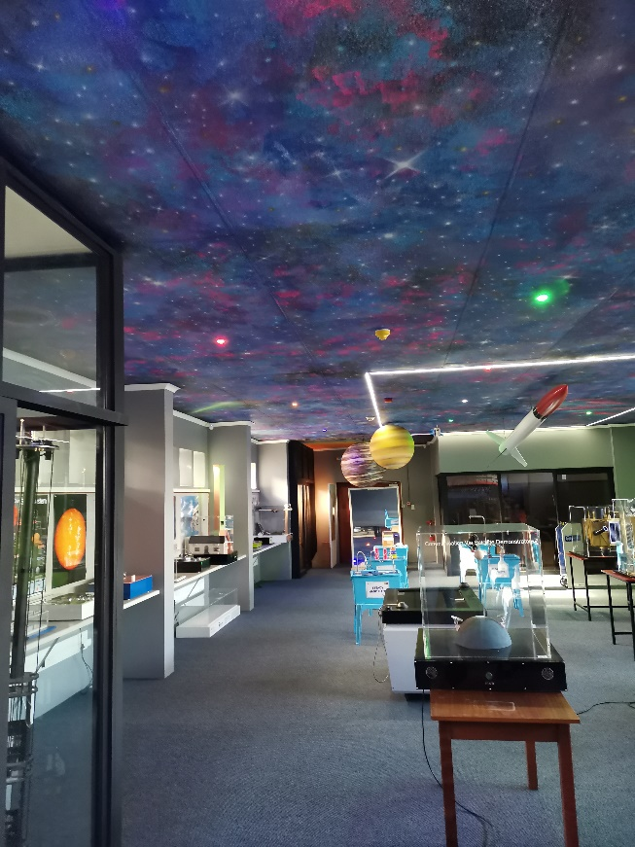
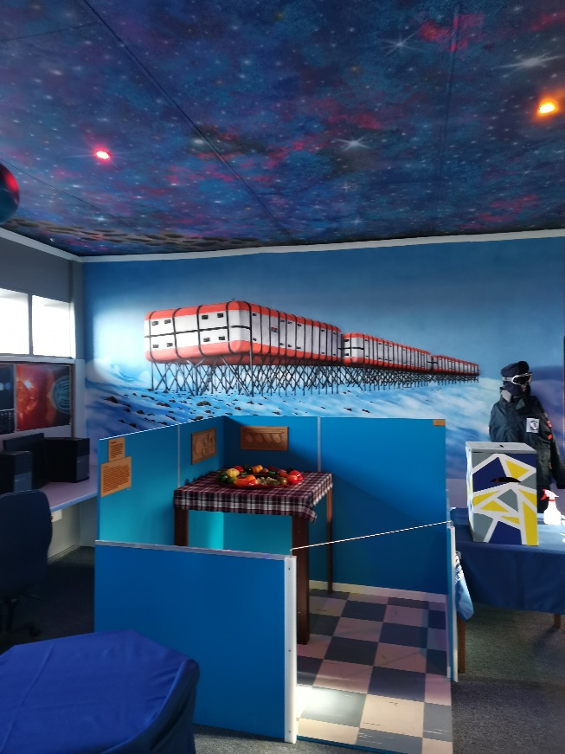
Exhibit Area
Floor size: 133 meter squared

Slide 9
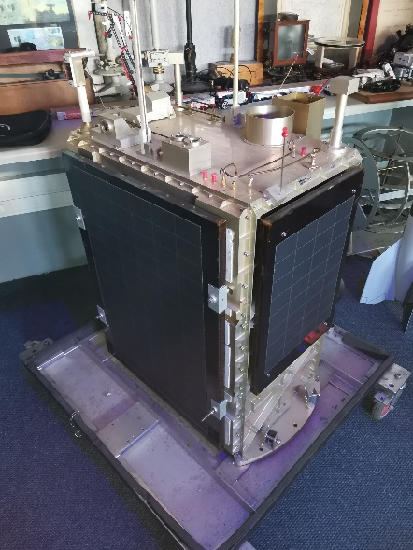
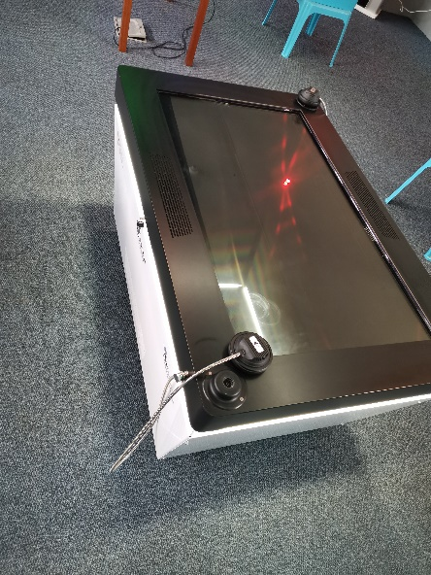
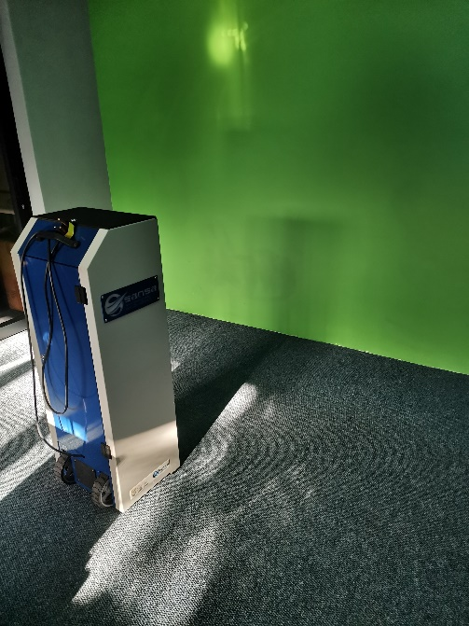
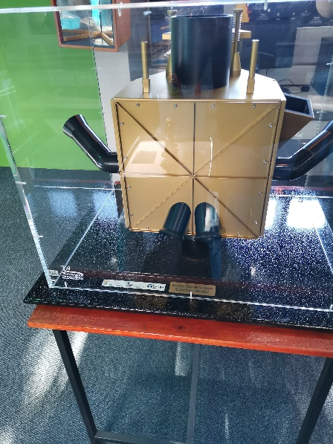
Interactive Exhibits
Combination of static and digital exhibits

Slide 10
Thank you
http://www.sansa.org.za
http://spaceweather.sansa.org.za
http://research.sansa.org.za

